Slide 1
AJA COP : Constrains Optimization Problem solving with Local Search algorithms.
Transportation Problem With extra additions further into the slide.

Slide 2
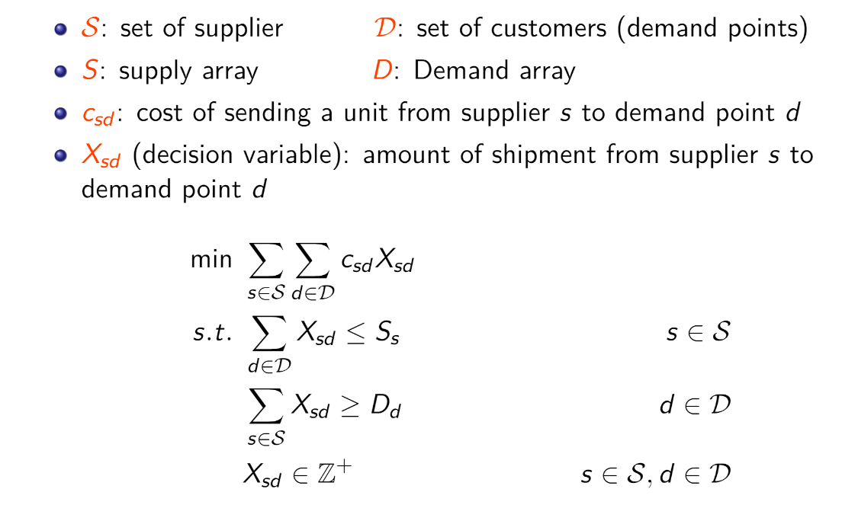
Initial Problem Introduction
Problem statement

Slide 3
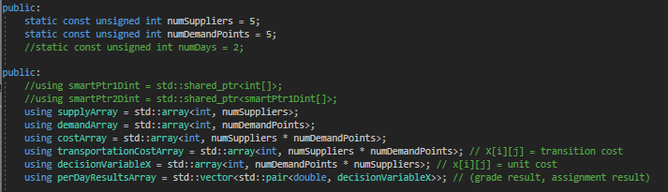
Vault Setup Parameters

Slide 4
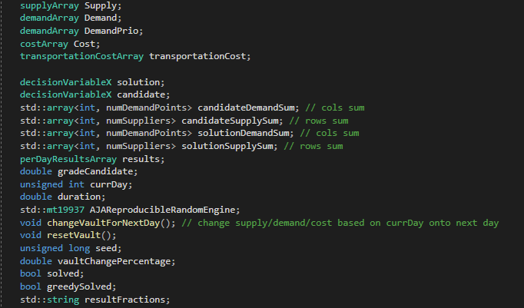
AJA_Data
Variables

Slide 5
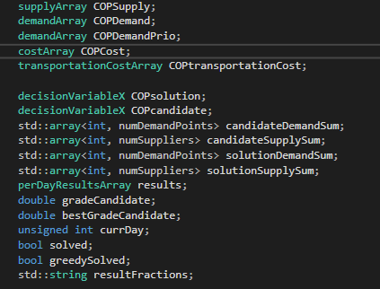
COP_Data
Very similar to AJA_Data

Slide 6

Algorithms used to find solution

Slide 7
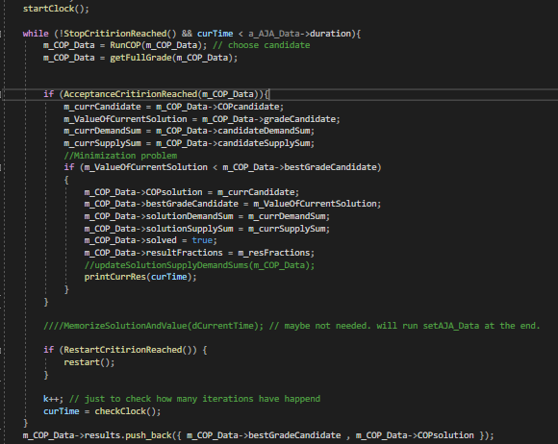
Fixed Time Search Main Algorithm

Slide 8
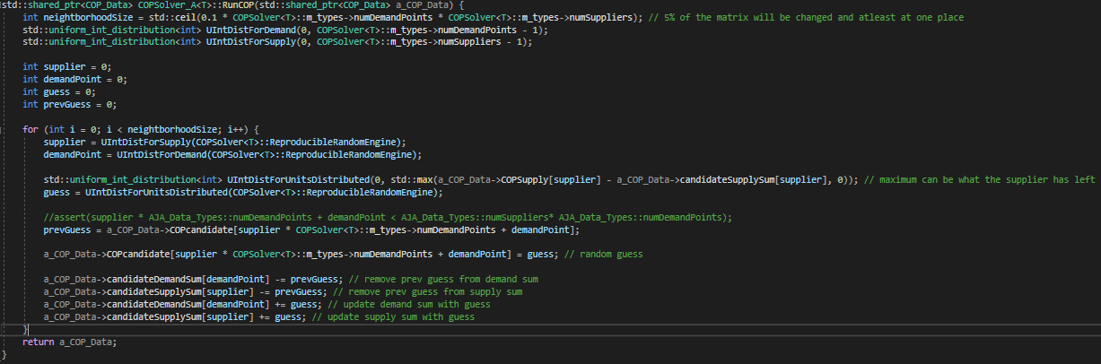
Stochastic Hill Climb

Slide 9
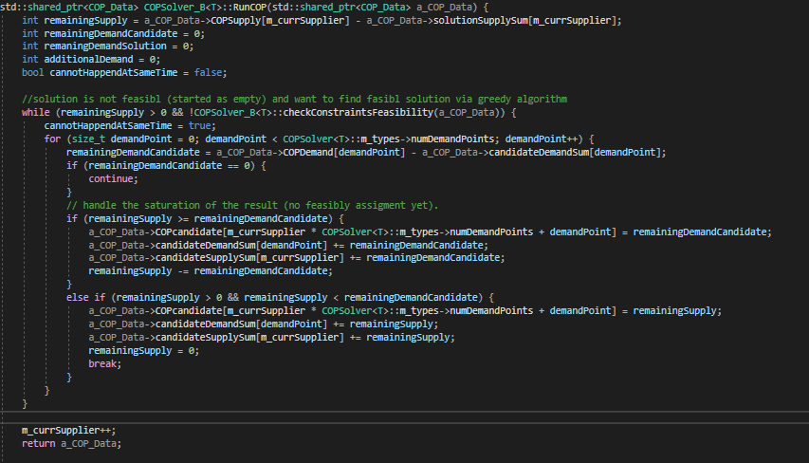
Greedy
Greedily supplying the current demand point with whatever is available, continue to next demand point when reached saturation.

Slide 10
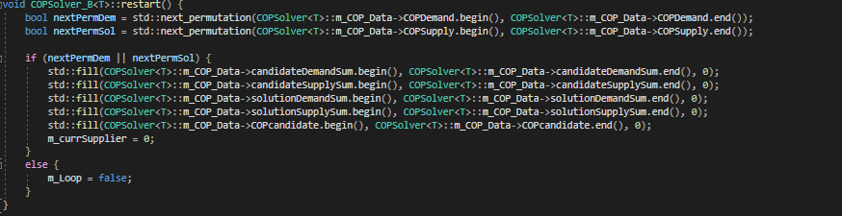
Greedy Loop
Same approach as Greedy but with restarts.
Used when there is a “small” gap between Supply and Demand.
Used to solve “assignment” problem
can design flow network and solve that way but this is not a fixed time search algorithm
Find the best assignment Ina a greedy way
Each restart performs the same greedy algorithm on a different permutation of suppliers and demands points.

Slide 11
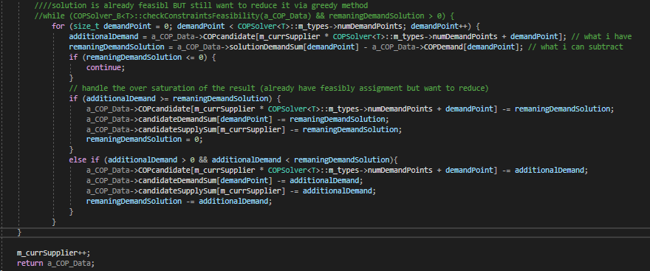
Greedy Correction
Subtracting excess products from demand points.
No reason to give a demand point x anything more than it requires.
Reaching better solution after running SHC algorithm.

Slide 12
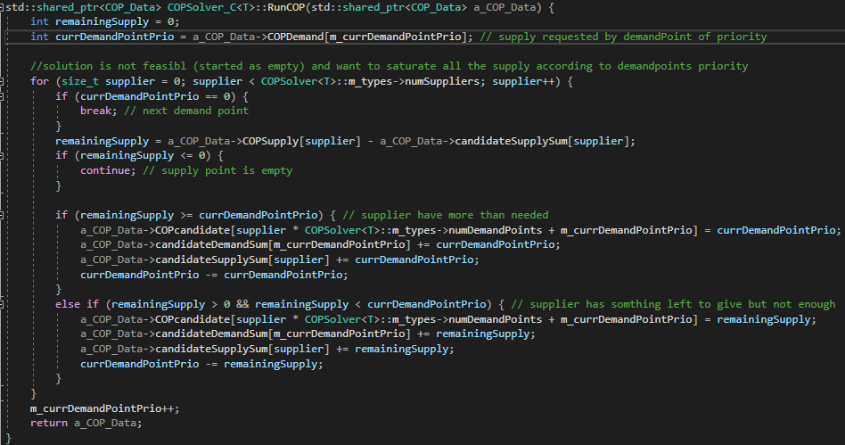
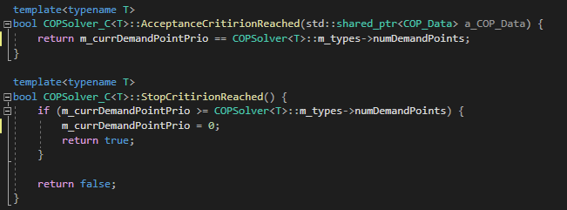
Greedy Saturation by Priority
Will run only when supply < demand i.e. unsolvable problem.
Saturating Demand Points by their priority.
The Demand Points are already sorted by Priority at this point.

Slide 13
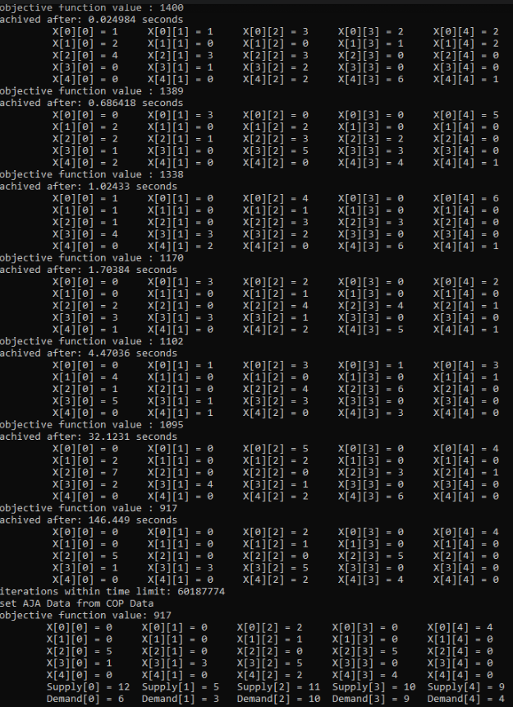
Initial problem statement solution output
Using only SHC algorithm in order to solve the problem.
Run time 180 seconds.
We can see that it does converge to optimal solution
i.e column[i] == demand[i]
Solution is rather slow and maybe we can stop earlier and run the Greedy Correction algorithm to achieve a similar result.
One difference might remain.
first of all optimal solution in a sense of column[i] == demand[i] will be achieved
but maybe a different assignment is better?

Slide 14
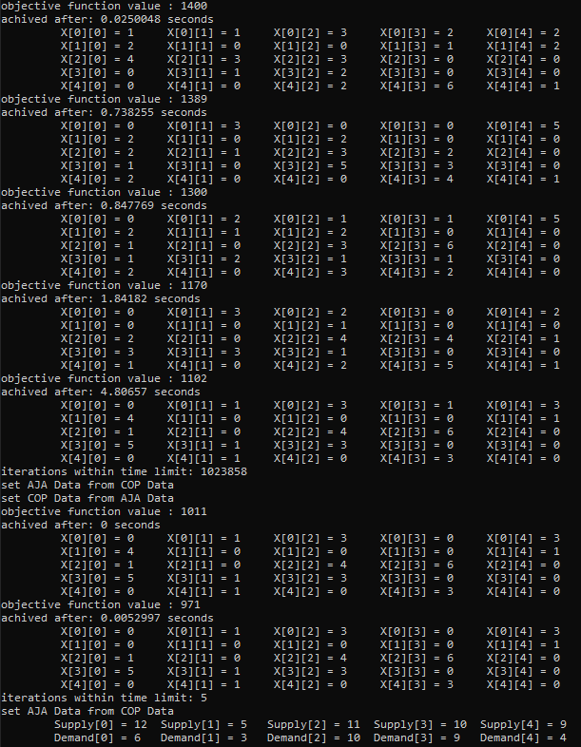
Initial problem statement solution Output with Greedy Correction
The same SHC algorithm ran on the same problem as previous slide.
Run time 10 seconds.
Greedy Correction ran Right after SHC and taking very little time.
Optimality achieved
in a sense of column[i] == demand[i]
Although result is less optimal overall.

Slide 15
Comparison
OPT_T1 := type 1 optimality, demand == supply
OPT_T2 := type 2 optimality, minimum cost achived
Without Greedy Correction
With Greedy Correction
Takes A lot longer to achieve OPT_T1.
Average Time to Reach OPT_T1:
160 seconds
Run Time exactly as assigned.
When runtime -> inf
|OPT_T2 – OPT_T1| < epsilon.
Can Reach OPT_T1 as soon as we get one feasible assignment.
Average Time to Reach OPT_T1:
Same time as reaching one feasible solution + epsilon
Average 2 seconds
Run Time = assigned time + epsilon.
When runtime -> inf
|OPT_T2 – OPT_T1| < epsilon.

Slide 16


Changing the Objective Function
$X_{n}$ is the Vault on day n. (Supply[i] = Si, Demand[i] = Di, Cost[i][j] = Cij, TransitCost[i][j] = Tij)
$f_{n}$ is the Initial objective function on day n.
$g_{n}$ is total transit cost between each "city" at day n
The resulting objective function tells the following: find the minimum such that: 80% of the focus is to minimize the current solution given day n vault. 10% to the difference between the amount assigned at day n, n-1, if there is a difference penalize it by a factor of 10. 10% to the difference between the locations in which transits have happened at day n, n-1, if there is a difference penalize if by a factor of 10.
$ObjFunction= min⁡\{0.8∙f_{n}\left(X_{n}\right)+ 0.1∙10∙\left|f_{n}\left(X_{n}\right) −f_{n−1}\left(X_{n−1}\right)\right| + 0.1∙10∙|g_{n}\left(X_{n}\right) −g_{n−1}\left(X_{n−1}\right)|\}$

Slide 17
Daily changes addition to the Problem
After solving the Initial problem statement, we have added a daily change in the vault in relation to the previous day.
The changes are random.
Supply, Demand, Cost, Transition Cost changes by some factor in relation to the previous day.
The direction of change (positive or negative) is random.
The change direction is independent of one another.
i.e., Supply and Demand can change to different directions.
Thanks to the changes being random unresolved solution might occur when demand is greater than supply.
When such a thing happens, the whole vault must be reset randomly.

Slide 18

Problems that occurred along the way
A few problems have occurred along the way of solving the problem efficiently.
First of all, not all problems are solvable.
When running two different algorithms on the same day we need to save the best result of the first algorithm for it to be the starting point of the second algorithm.
Furthermore, we need to compare the previous day result with the current day result.
But what if the previous day is unsolvable?
Can SHC solve every Solvable problem in a feasible time?
Can GreedyLoop be stopped after running through all permutations?
In here I will explain my approach to the problems I have faced.

Slide 19
My solutions to those problems and more
Results need to be saved every day.
Everyday we check if there is some minimal “distance” between supply and demand percentage wise, also called tolerance.
My finding were that regarding to this problem one appropriate tolerance is 13% any lower than that SHC would run for a very long time.
If that distance is greater than 13%, we first run SHC and then Greedy Correction.
Else we run GreedyLoop and initialize the solver to be SHC for the next day.
If the previous day is unsolvable, we need to find the last day that it was solvable and evaluate according to this solution.
First, we always use the SupplySum and DemandSum arrays.
Everyday regardless of the situation they reset to 0 because no assignment was evaluated.
Meaning that if we take the last solved day after a failure has occurred, we can easily fetch the solution of that day, but the variables mentioned above will still be initialized to all 0.
My solution was to update those variables each call to the algorithm meaning the update calculation will happened only once at the start of each day. (twice if we solve with two algorithms).
GreedyLoop can be stopped after it ran through all possible permutations if we just turn the loop flag down when no other permutation is available.
But turning it down means that we cannot run GreedyLoop again, so to fix that I created a Setter for such a flag that will run after every GreedyLoop, setting this flag up again for the future.
For the unsolvable problems we define a priority order for the demand points and saturate them by their priority in a greedy way.
Stop when finished saturating.

Slide 20
Conclusions
SHC cannot solve every solvable problem.
If reaction time is more critical than the overall optimal result, then
First run SHC.
Correct the result with Greedy Correction.
Result is optimal regarding satisfying all demand quotas and nothing above.
There is a tolerance between supply and demand which disturbs the SHC algorithm
My finding were that if the difference is above 13% between them SHC doesn’t work in a feasibly time.
Solve such problems with “assignment algorithms” in this context its GreedyLoop.

